Slide 1

Verilog HDL (Sequential Circuit Design)
Winter 1400 (Computer Aided Design)
Meisam Abdollahi
School of Computer Engineering
Iran University of Science and Technology
meisam.abdolahi@ut.ac.ir

Slide 2
Some Coding Practices
Some coding practices while writing synthesizable Verilog for sequential hardware
Use an edge-triggered clock in the sensitivity list using the posedge or negedge keywords.
Use non-blocking assignments—that is, “<=” inside always blocks although it is possible to get sequential hardware by certain uses of the blocking “=” operator.
Do not mix blocking and non-blocking statements in an always block.
Do not make assignments to the same variable from more than one always block.
Avoid unwanted latches by assigning a value to combinational output signals in every possible execution path in the always block.
Including else clauses for if statements,
Specifying all cases for case statements or have a default clause at the end
Unconditionally assigning default values to all combinational output signals at the beginning of the always block.

Slide 3
Design Modeling Approaches
Behavioural Modeilng
Describe the circuit or system at a high level of abstraction without implying any particular structure or technology.
Behavioral modeling describes the functionality of a design - that is, what the designed circuit will do, not how to build it in hardware.
Aside from its importance in synthesis, behavioral modeling provides flexibility to a design project by allowing portions of the design to be modeled at different levels of abstraction and completeness.
Structural Modeling
The components used and the structure of the interconnection between the components are clearly specified.
The structural Verilog model is at a low level of abstraction.

Slide 4
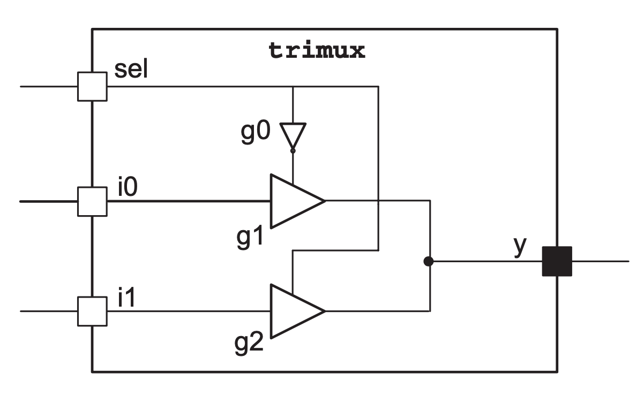
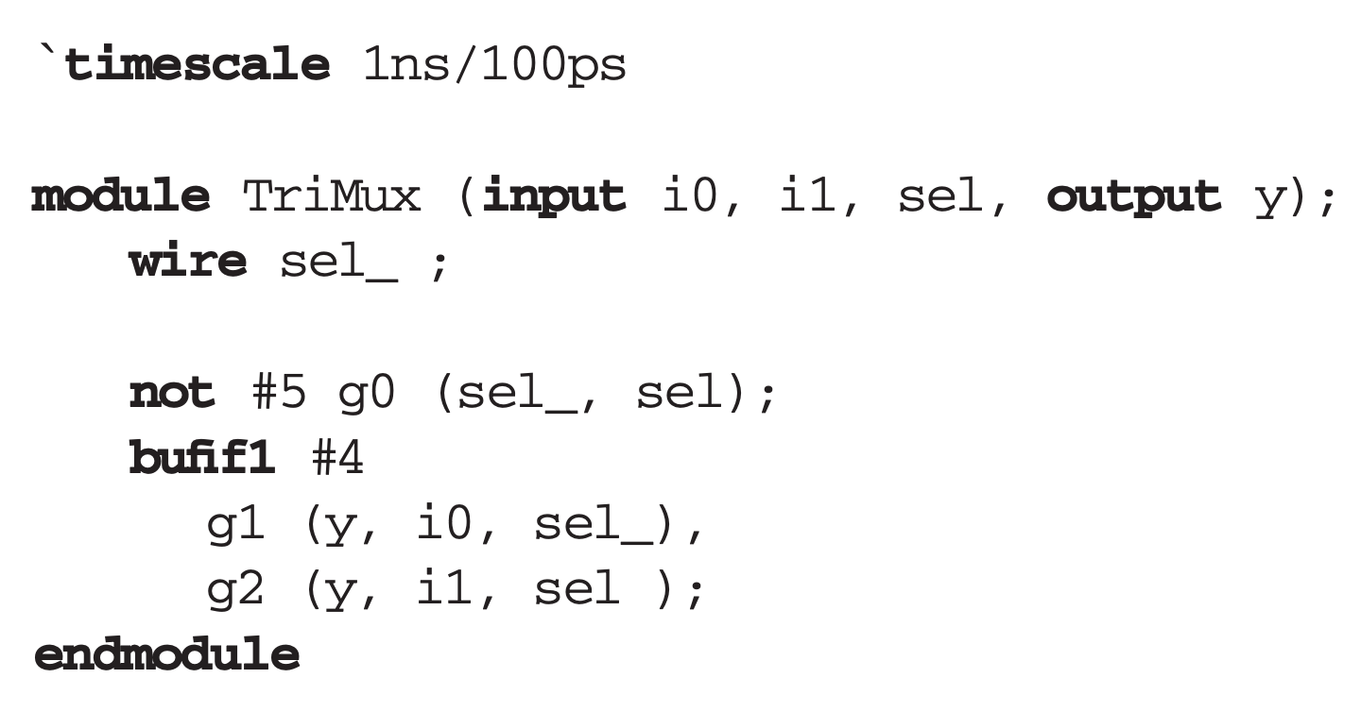
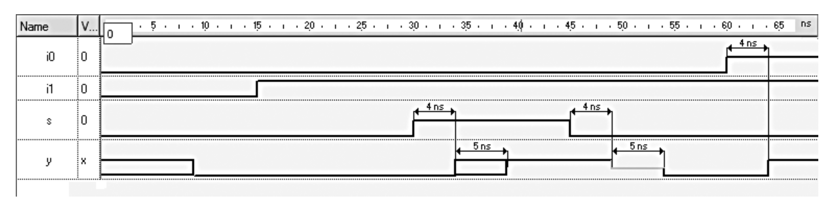
Wire Values and Timing
@34: both g1 and g2 conduct
@34: neither g1 nor g2 conduct
Notes:
The 1ns/100ps used in this example indicates that all timing values are in ns, and the time precision is 100ps, or 0.1ns.
This means that we can specify time values with one fractional digit (0.1ns).

Slide 5
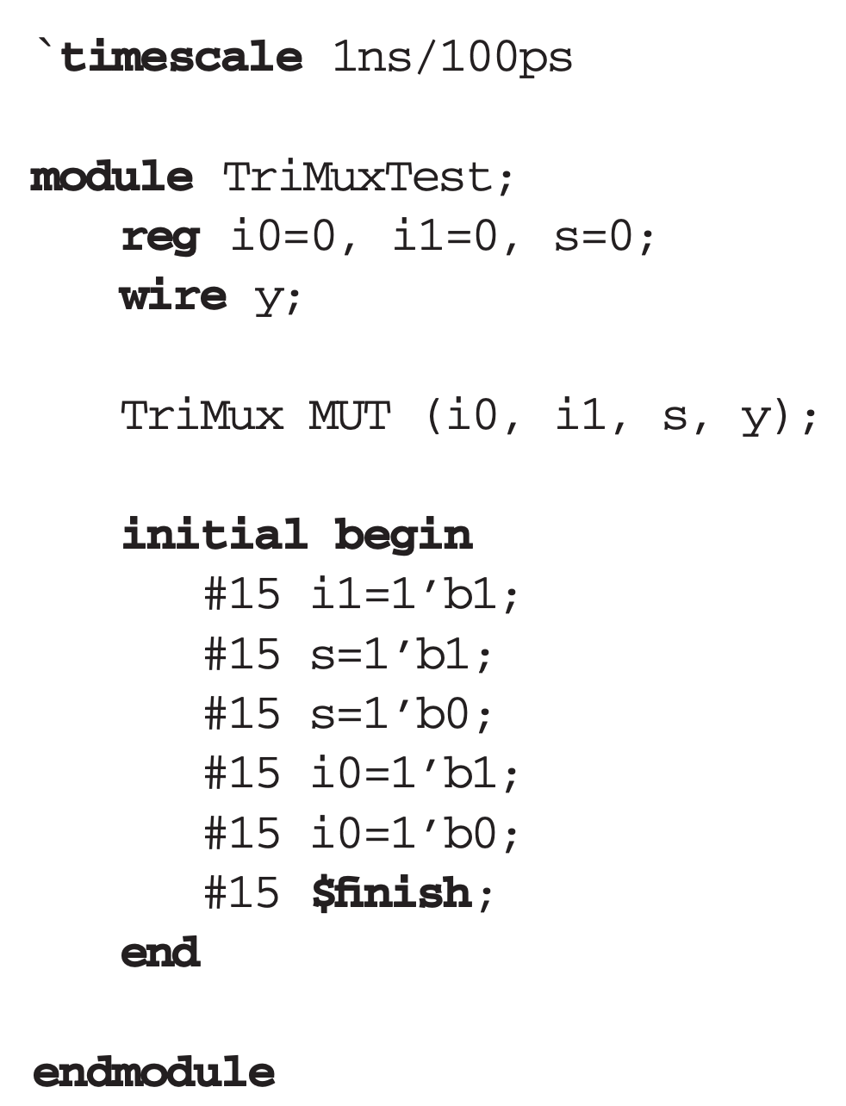
A simple testbench
Because i0, i1, and s must be assigned values in this testbench, they are declared as reg and initialized to 0.
the $finish simulation control task finishes the simulation run.

Slide 6
User defined primitives
For simple functions for which Verilog does not provide a primitive, a user- defined primitive (UDP) can be formed.
A combinational UDP can form a combinational function of up to 10 inputs and one output.
The definition of a UDP can only include a table in the form of a logical Truth Table.
UDP output can only be specified as a 0 or a 1. The Z value cannot be specified, and an X happens for unspecified input combinations.
A UDP definition cannot include delay values, except when you instantiate it.

Slide 7
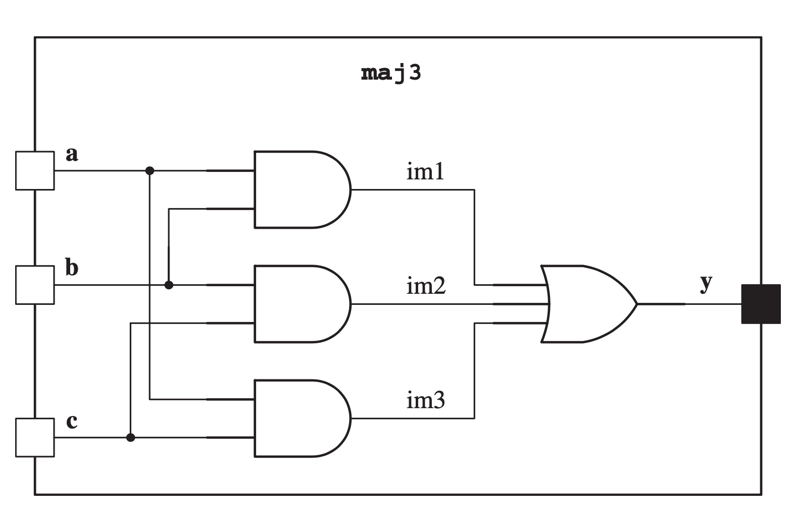
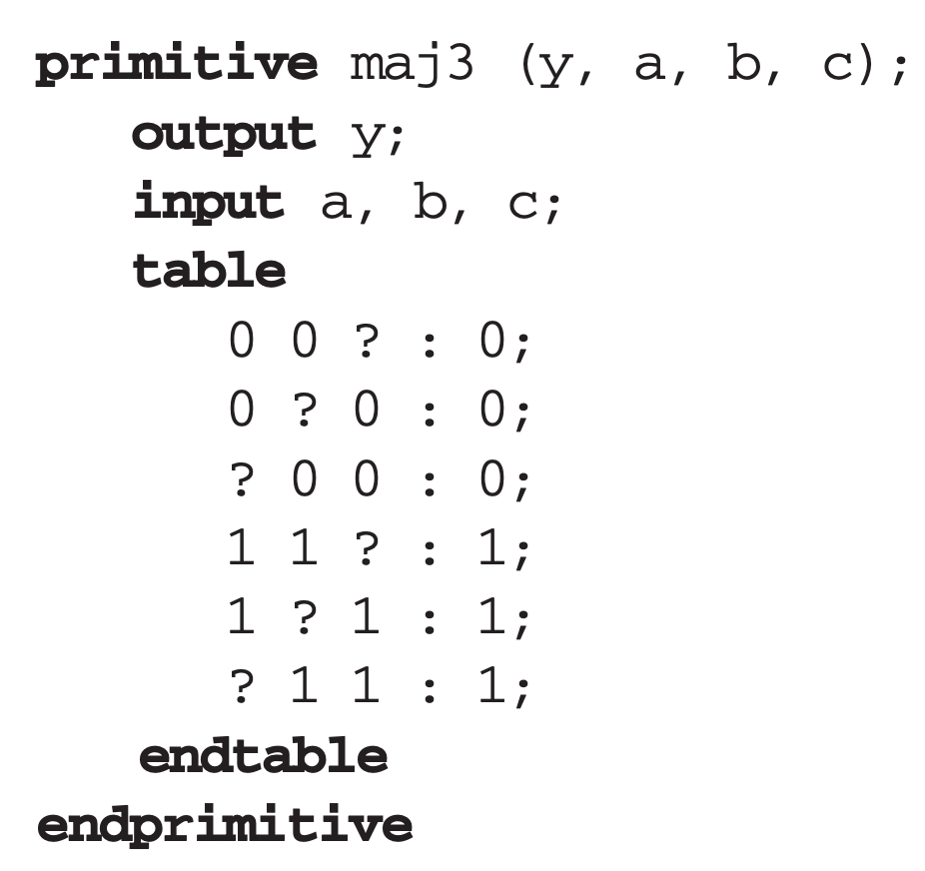
User defined primitives
A UDP definition begins with primitive keyword, and after its name, its ports are defined. The output of a UDP is always first in its port list.
A UDP is instantiated like a system primitive.
ordering of inputs: according to the declaration of inputs
0,1, X

Slide 8
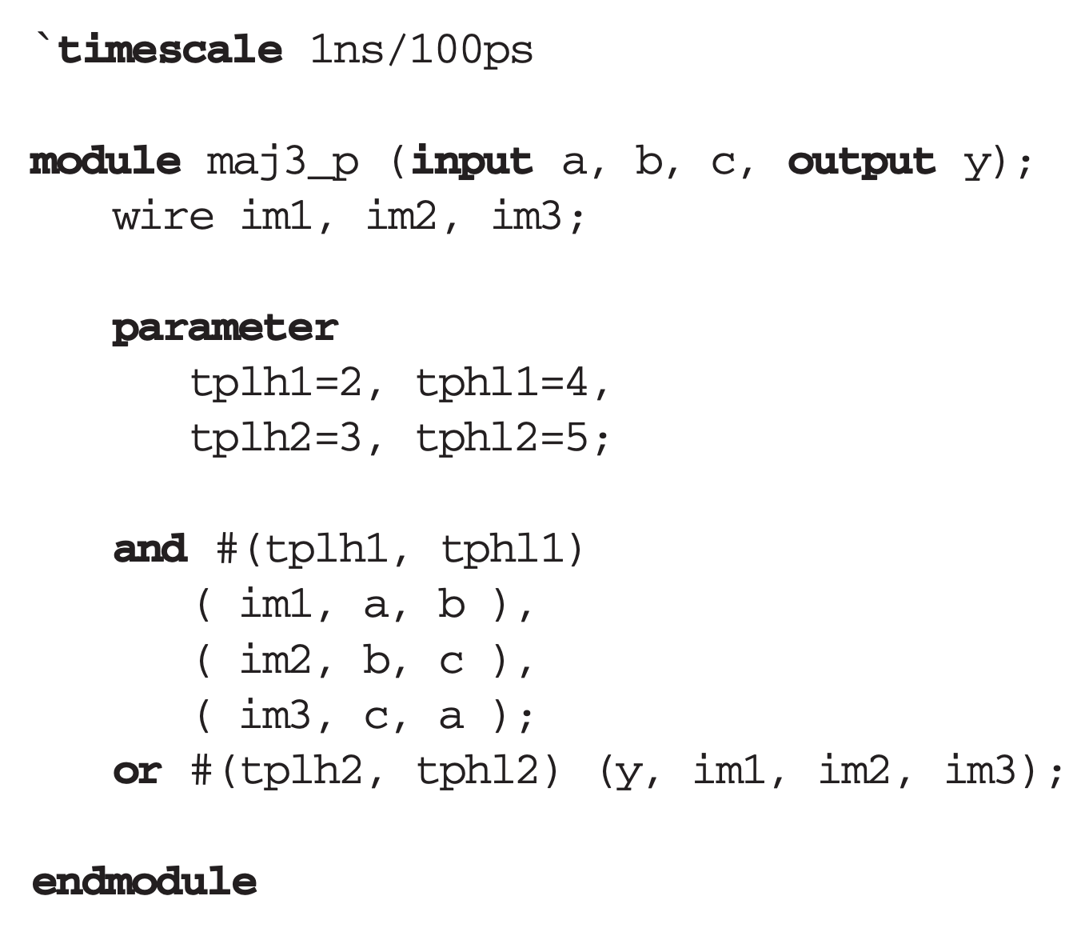
Module Parameters
Parameters can be used for defining the module constants like delay values.
Module parameters can be a localparam for local parameters or a parameter (global).
A local parameter of a module cannot be changed from outside of the module, whereas a parameter can.
A parameter declaration begins with the parameter/localparam keyword and is followed by individual parameters and their constant values.

Slide 9
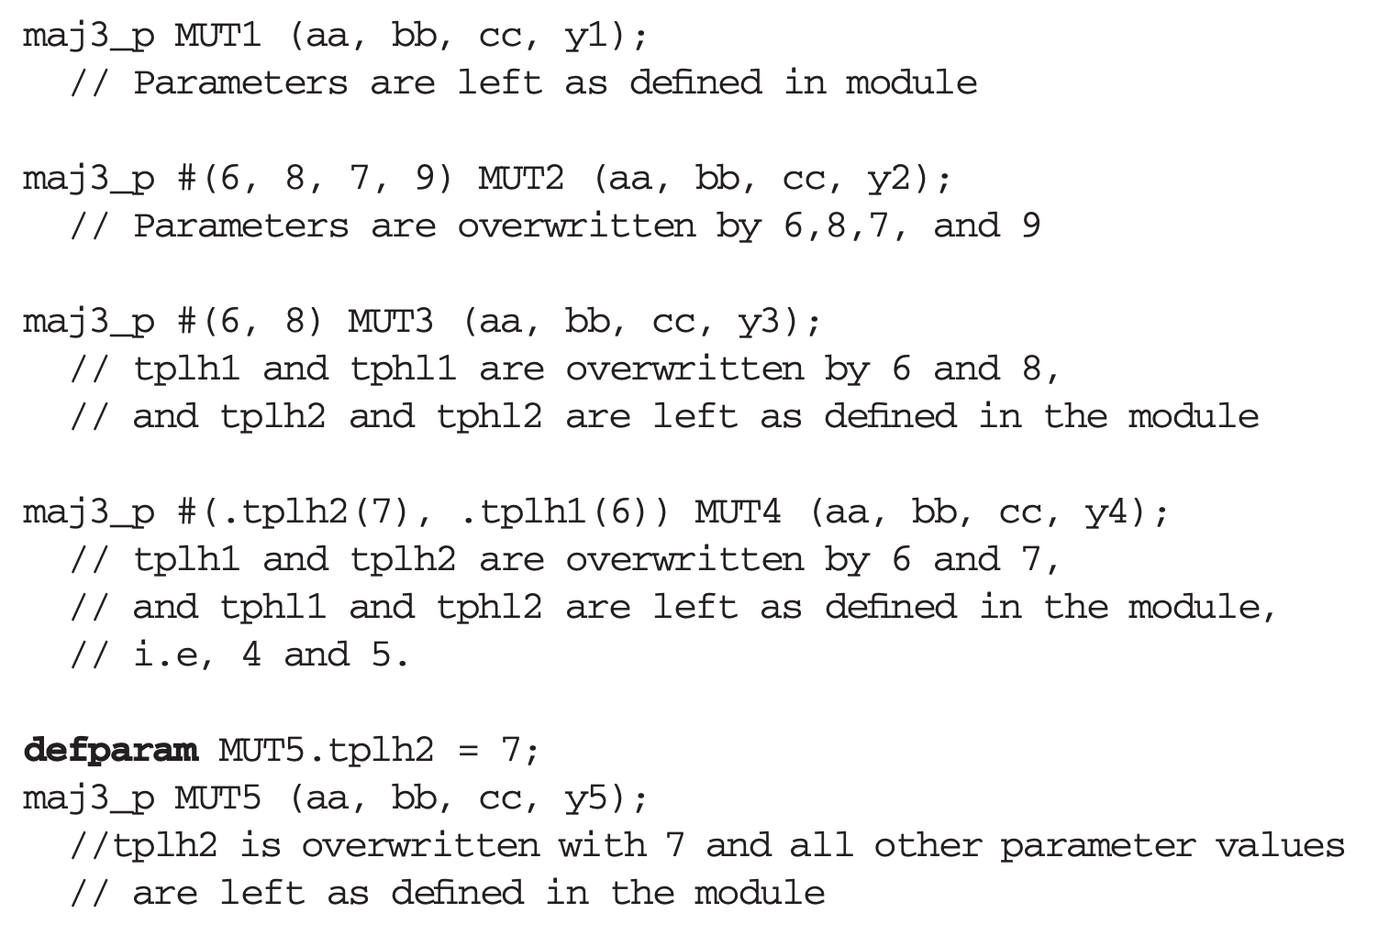
Parameterized Module Instantiation
This construct is referred to as parameter override

Slide 10
Iterative structures
when dealing with large regular multidimensional structures.
For example, if we were to wire a 64-bit combinational array multiplier
Listing 64*64 instances of individual bit multipliers and specifying the wiring of each of these units would become a very time consuming and error-prone task.
For formation of iterative structures and wiring specification of regular structures, Verilog provides two constructs
Array of instances
Generate statement

Slide 11
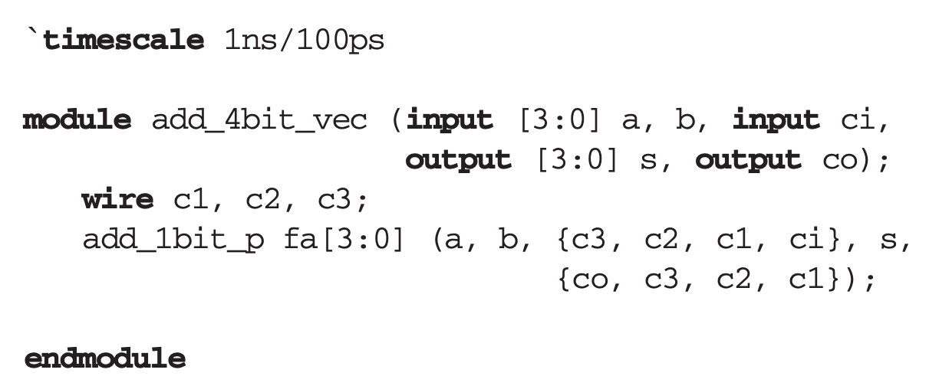
Array of Instances

Slide 12
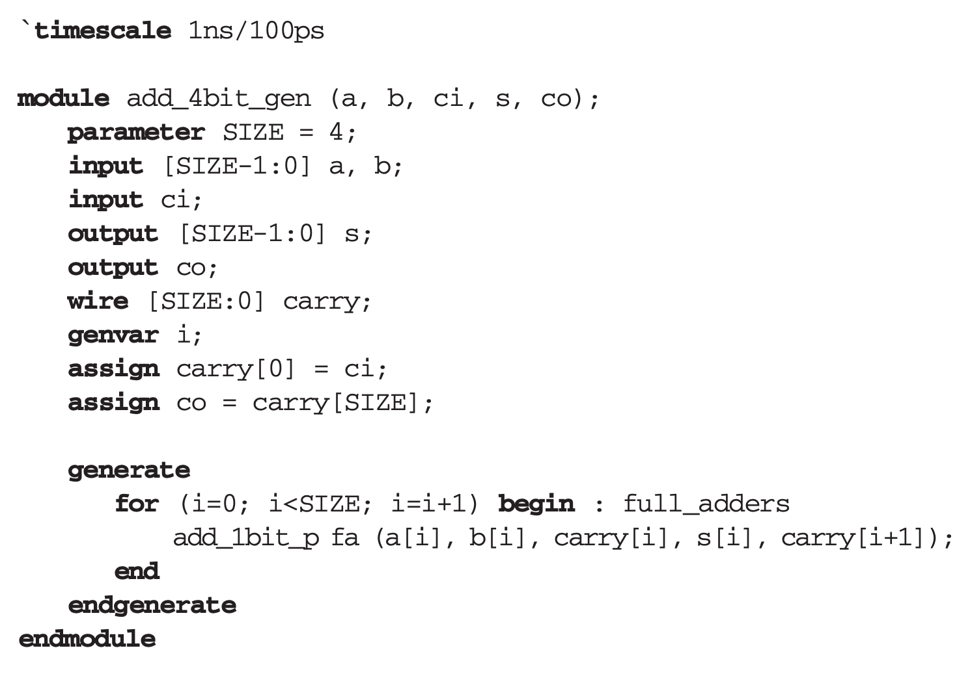
Generating multiple instances
The identifier for the for statement:
the sum output of add_1bit_p in position 3 is referenced by full_adders[3].fa.sum

Slide 13
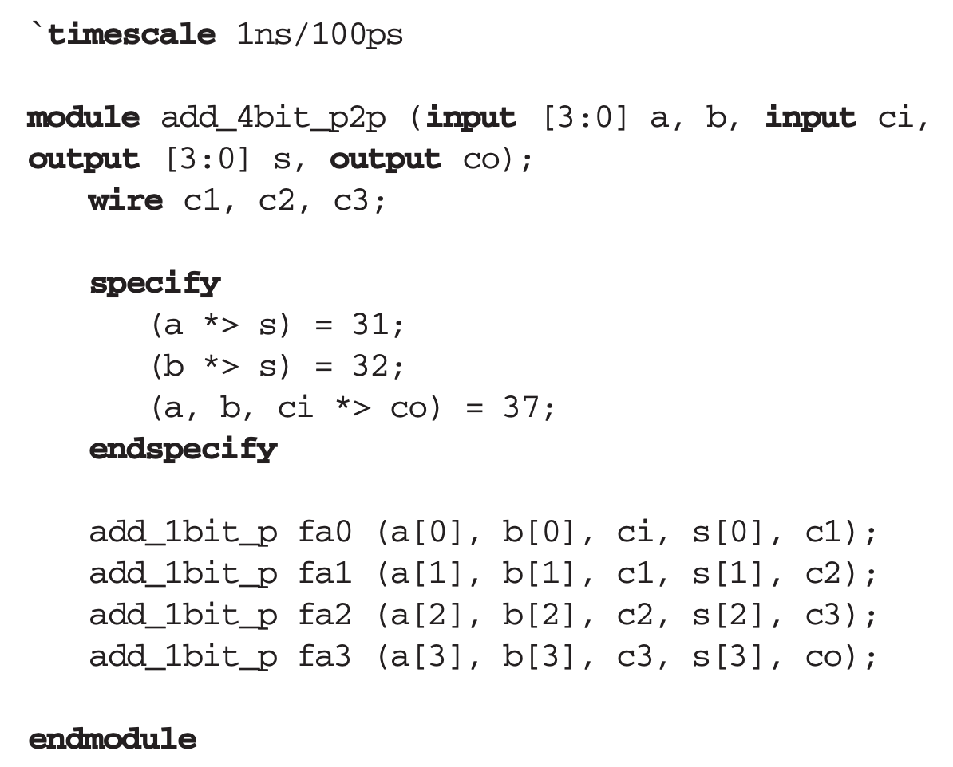
Module Path Delay/Pin-to-Pin Delay
A module path delay specification describes the time it takes an event at a source (input or inout port) to propagate to a destination, e.g., an output.
Module path delays (pin-to-pin) are specified in a specify block inside a module.
A specify block begins with the specify keyword and ends with endspecify.
Within a specify block, input to output path delays can be specified.
Module paths not specified in a specify block are considered with 0 pin-to-pin delays.
Notes:
Path delays shown for a to s and b to s are full-path, which means an event on any bit of a to a resulting change on any bit of s is delayed by 31 ns. The same for bits of b to s is 32 ns. In addition, we are specifying the delay from any bit of a, or b or ci to co as 37 ns.
Another path delay specification format in Verilog is what is referred to as parallel path. This format uses => instead of *> for vector source to destinations. The (a=>s) = 12 path delay specification defines events on bits of a to similar bits of s to be 12 ns. This means that if an event on a[1] causes s[1] and s[3] to change, the 12 ns delay only applies to s[1] and distributed delays will be used for changes on s[3].

Slide 14
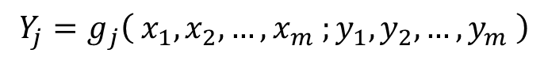
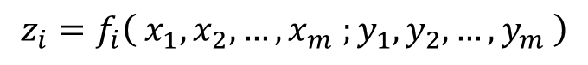
Design of A Sequential Circuit
$$z_{i}=f_{i}\left( x_{1},x_{2},…,x_{m} ;y_{1},y_{2},…,y_{m} \right)$$
$$Y_{j}=g_{j}\left( x_{1},x_{2},…,x_{m} ;y_{1},y_{2},…,y_{m} \right)$$

Slide 15
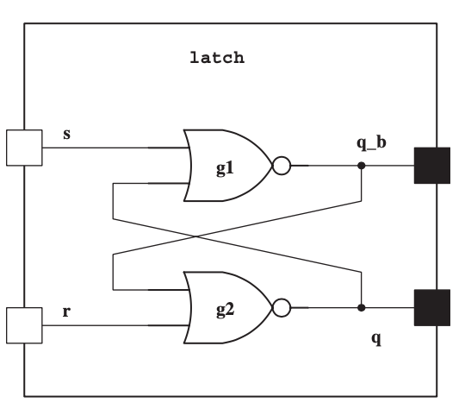
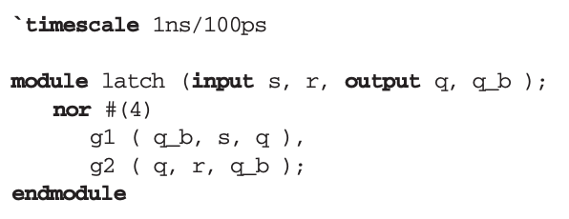
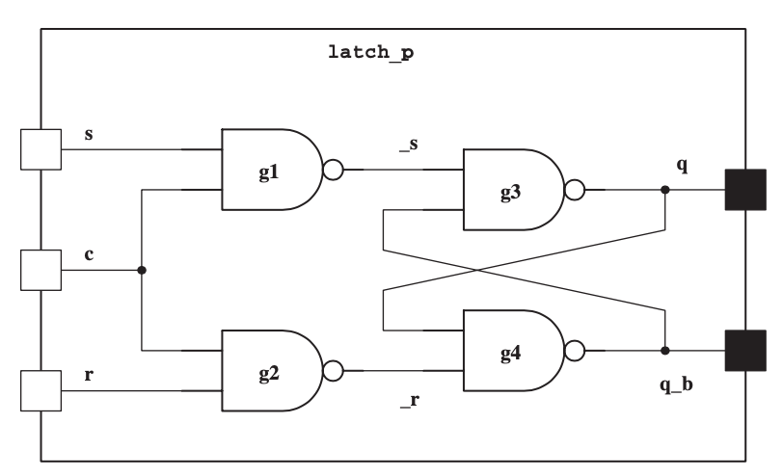
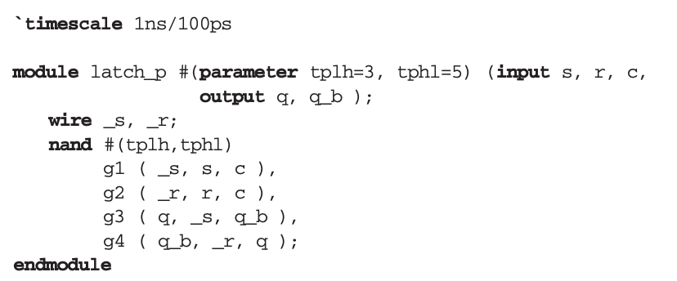
Structural Modeling of Memory Components: Latches

Slide 16
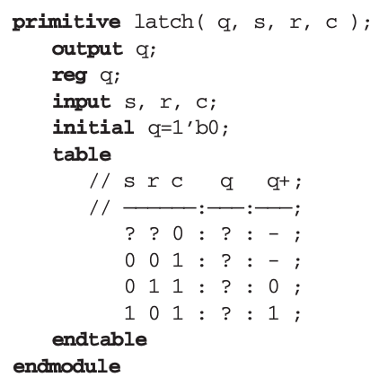
User defined sequential primitives
No Change

Slide 17
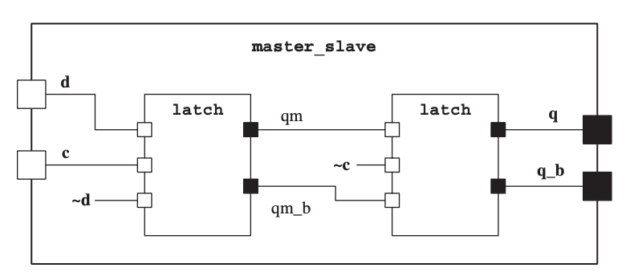
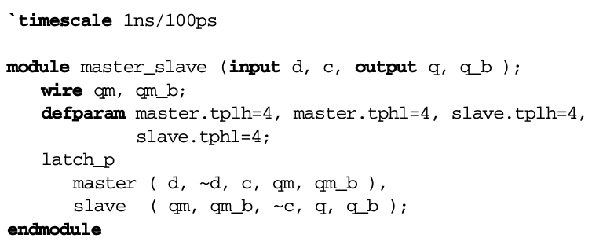
Structural Modeling of Memory Components: Flip Flops

Slide 18
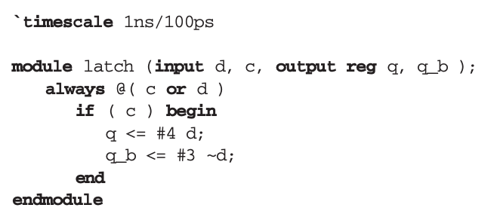
Behavioral memory elements: Latches

Slide 19
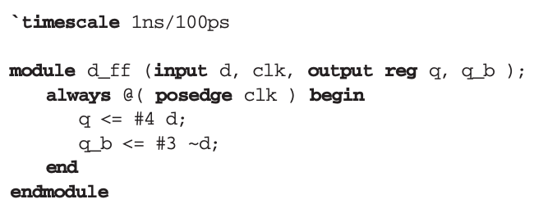
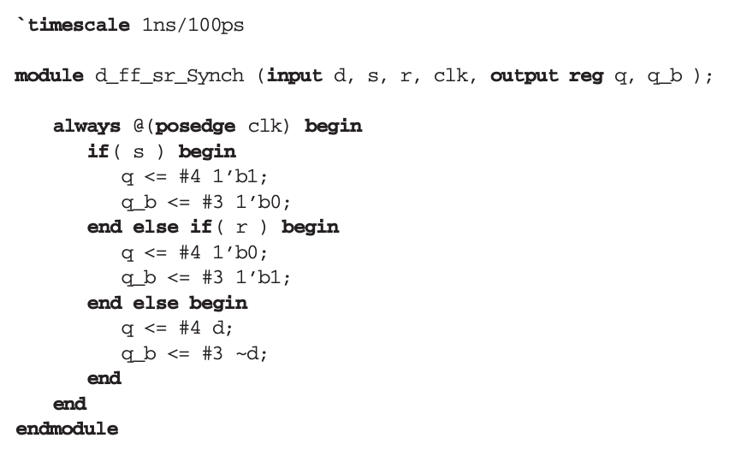
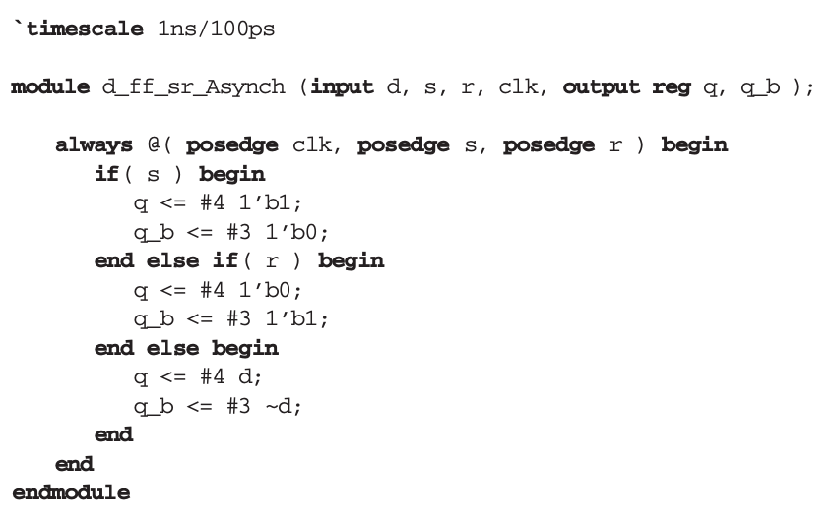
Behavioral memory elements: Flip Flops
Positive Edge Trigger Flip-Flop
D Type Flip-Flop with Synchronous Control
D-type Flip-Flop with Asynchronous Control

Slide 20
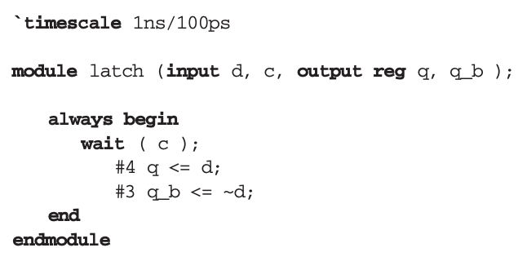
Other storage element modeling styles
Because an always statement repeats itself forever, if c becomes 1 and remains at this value
the body of the always statement repeats itself every 7 ns due to the delay control statements.
If these delays are omitted, then the looping of the body of the always statement happens in zero time causing an infinite loop in simulation.
The wait statement shown is a procedural statement that blocks the flow of the procedural block when c is 0. When c becomes 1, the wait statement allows the program flow to pass it and reach assignments to q and q_b.
Notes:
The wait statement shown is a procedural statement that blocks the flow of the procedural block when c is 0. When c becomes 1, the wait statement allows the program flow to pass it and reach assignments to q and q_b.

Slide 21
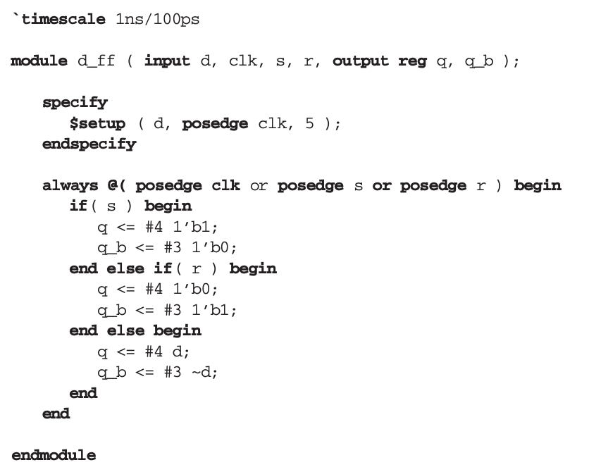
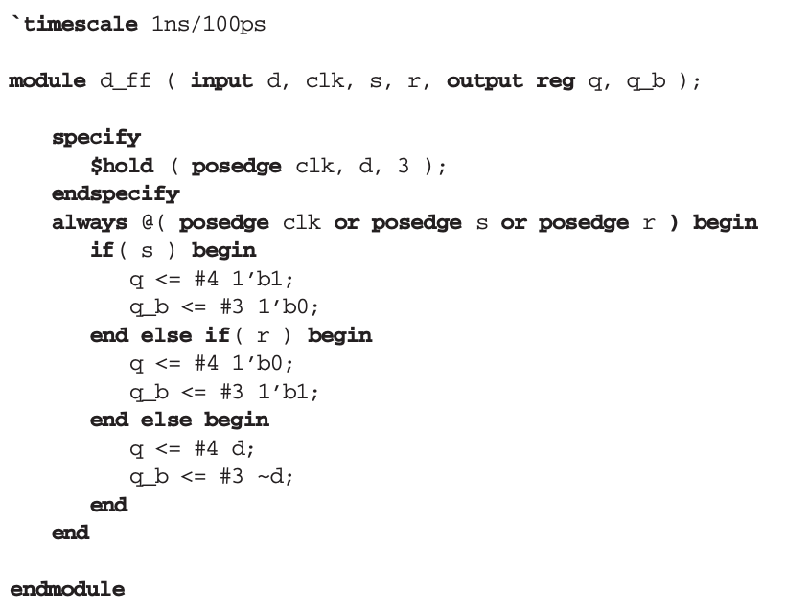
Flip Flop Timing
Notes:
Setup time is defined as the minimum necessary time that a data input requires to setup before it is clocked into a flipflop.
Hold time is defined as the minimum necessary time a flip-flop data input must stay stable (hold its value) after it is clocked.
the $setup task that is used within the specify block continuously checks the timing distance between changes on d and the positive edge of the clk clock. If this distance is less than 5 ns, a violation message will be issued.
The Verilog $setuphold task combines setup and hold timing checks. The following replaces both tasks used in Figs. 5.25 and 5.27. $setuphold (posedge clk, d, 5, 3);

Slide 22
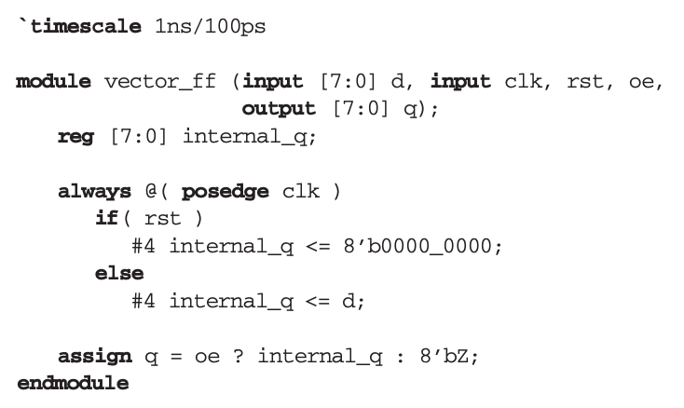
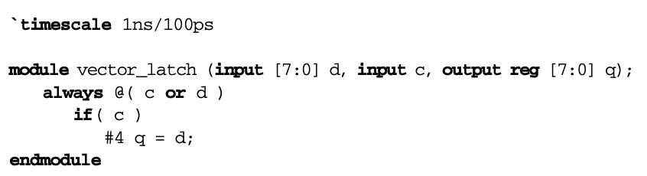
Memory vectors
8-bit Transparent D-Latch
An 8-bit Register with Tri-State Output

Slide 23
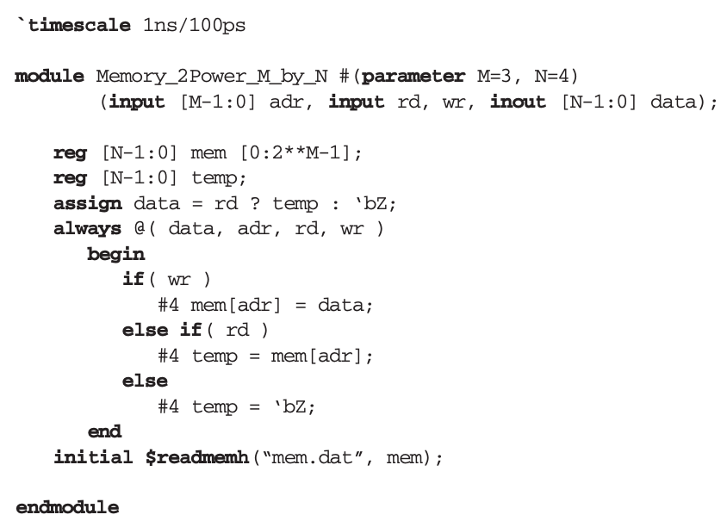
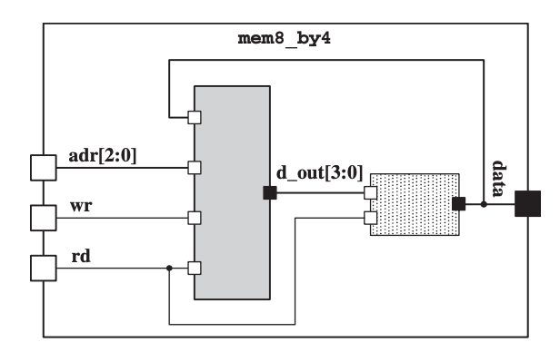
Memory Arrays
Notes:
Verilog has the $readmemh and $readmemb tasks for reading external data files and using them for initialization of memory blocks.
Data from mem.dat external data file is read and the memory is initialized with this data. As shown in this example, an initial statement invokes $readmemh at time 0. At this time, data words from mem.dat are read and are sequentially placed in the words of mem. Each line in mem.dat corresponds to a word of mem (starting from location 0), and data words are expected to be in hexadecimal. Optionally,
invocation of $readmemh task may contain a range of the memory words to fill. The $readmemb task is similar to $readmemh, except that each line of the file read is expected to contain binary data equivalent to the word length of the memory.

Slide 24
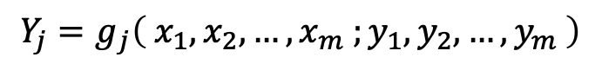
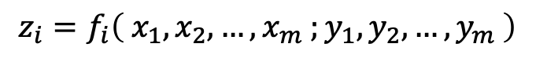
Design of A Sequential Circuit
$$z_{i}=f_{i}\left( x_{1},x_{2},…,x_{m} ;y_{1},y_{2},…,y_{m} \right)$$
$$Y_{j}=g_{j}\left( x_{1},x_{2},…,x_{m} ;y_{1},y_{2},…,y_{m} \right)$$

Slide 25
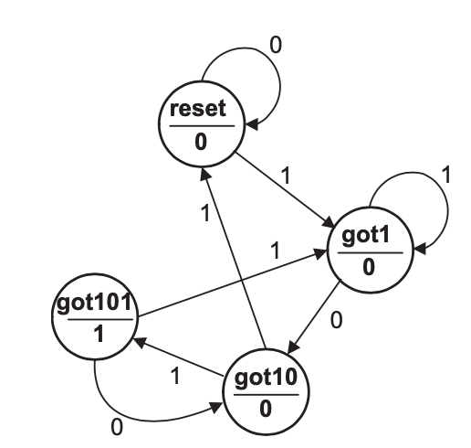
Moore Machines
A Moore machine is a state machine in which all outputs are fully synchronized with the circuit clock.
In the state diagram form, each state of the machine specifies its output(s) independent of circuit inputs.
In the Verilog code of a Moore state machine, only circuit state variables participate in the output expression of the circuit.
A Moore 101 Detector

Slide 26
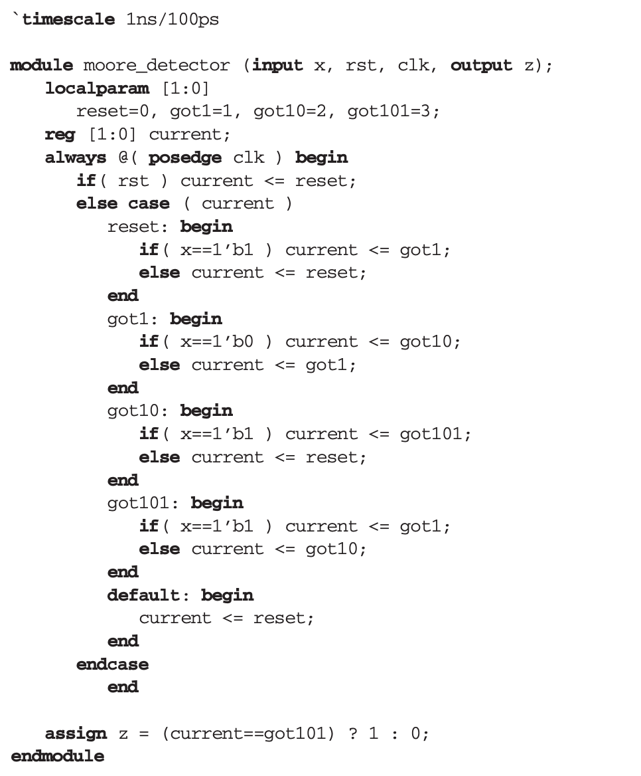
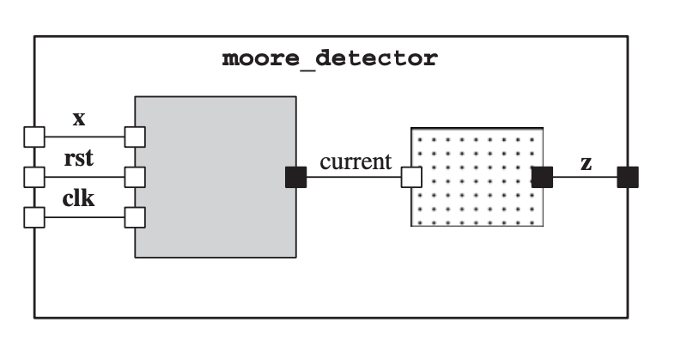
A Moore 101 Detector

Slide 27
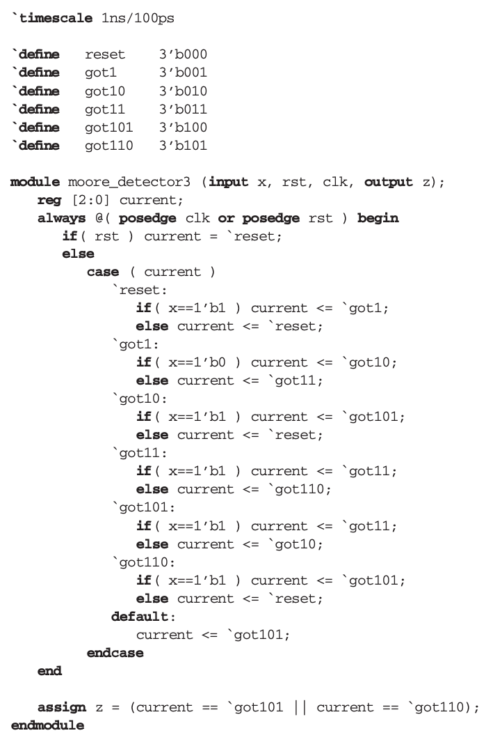
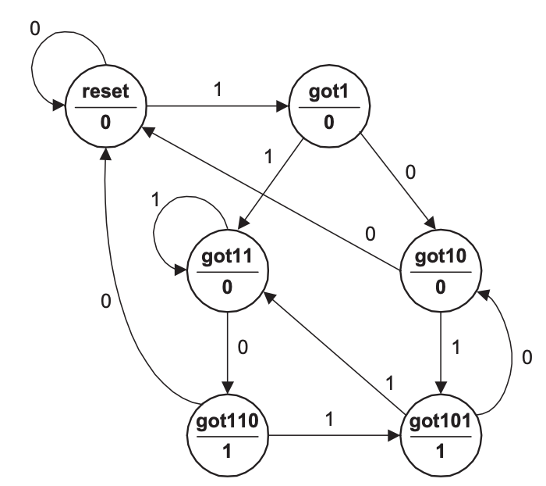
Another Example: Moore Machine Detecting 110/101

Slide 28
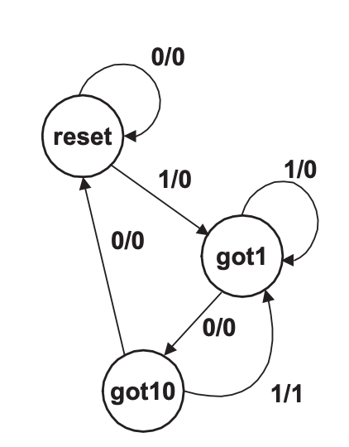
Mealy Machine
A Mealy machine is different from a Moore machine in that its output(s) depend on its current state and inputs while in that state.
State transitions, clocking, and resetting the machine are not different from those of a Moore machine, and the same coding techniques are used for describing them.
A 101 Mealy Machine

Slide 29
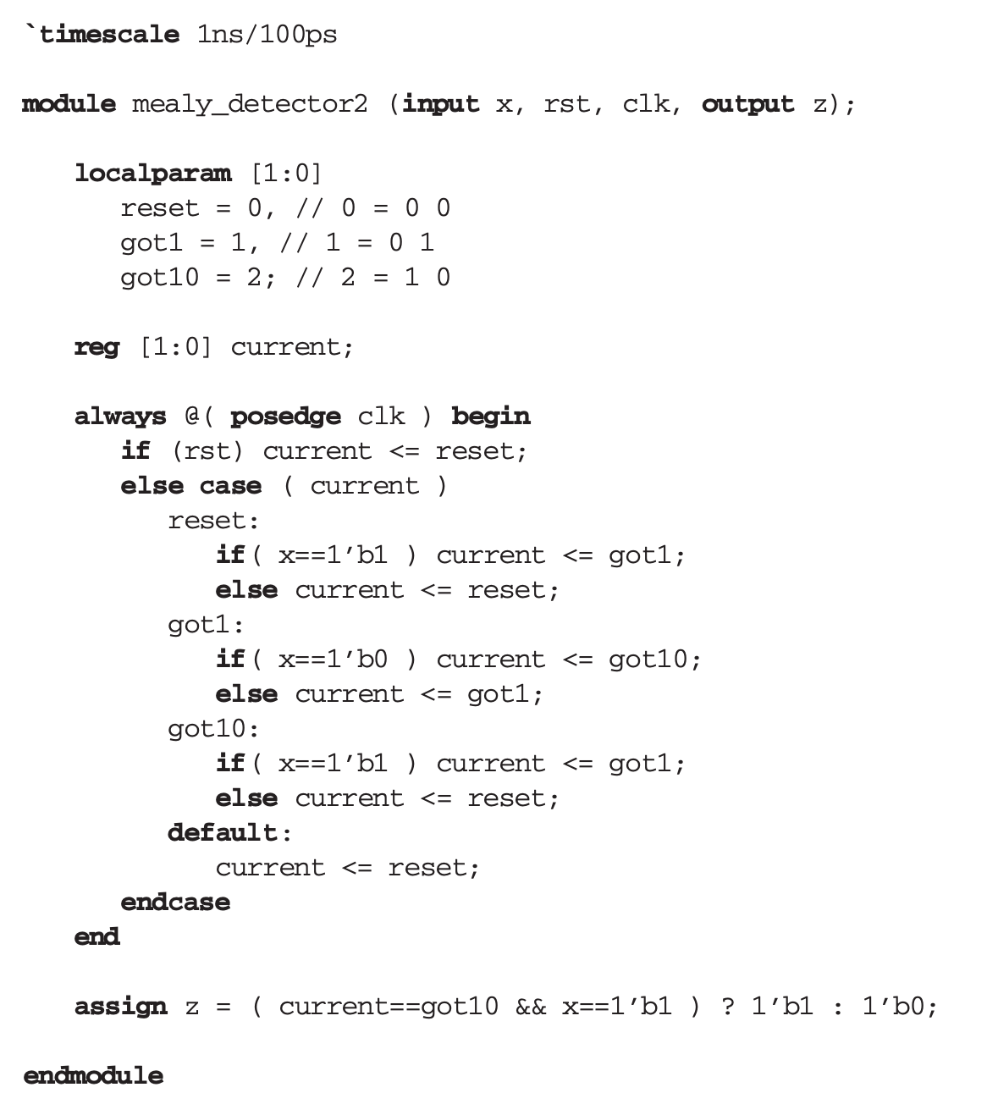
Verilog Code for a 101 Mealy Machine

Slide 30
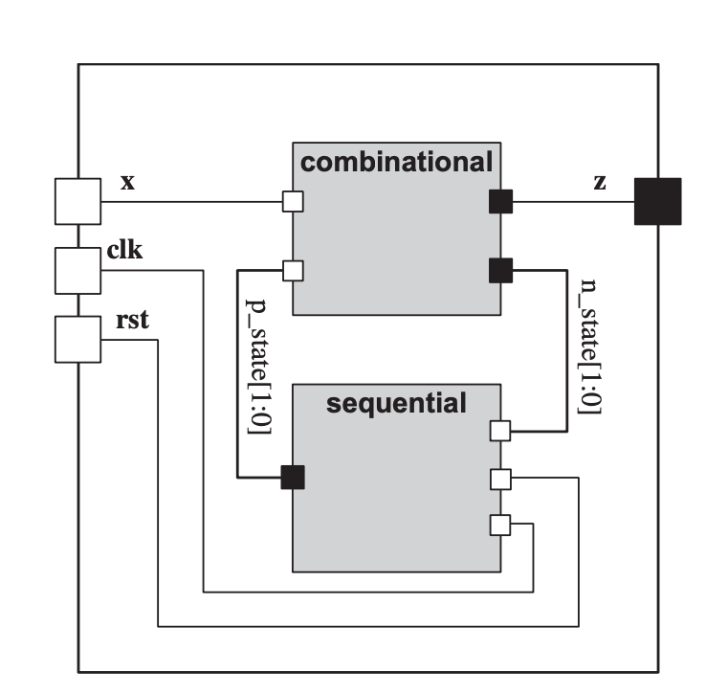
Huffman coding style
The Huffman model for a digital system characterizes it as a combinational block with feedbacks through an array of registers.
According to the Huffman model, Verilog coding of digital systems uses
an always statement for describing the register part
an always statements for describing the combinational part.
The advantage of this style of coding is in its modularity and defined tasks of each block.

Slide 31
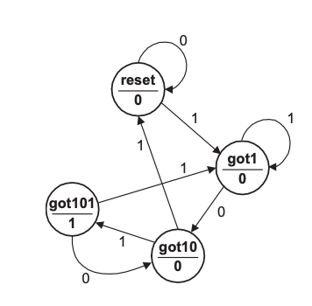
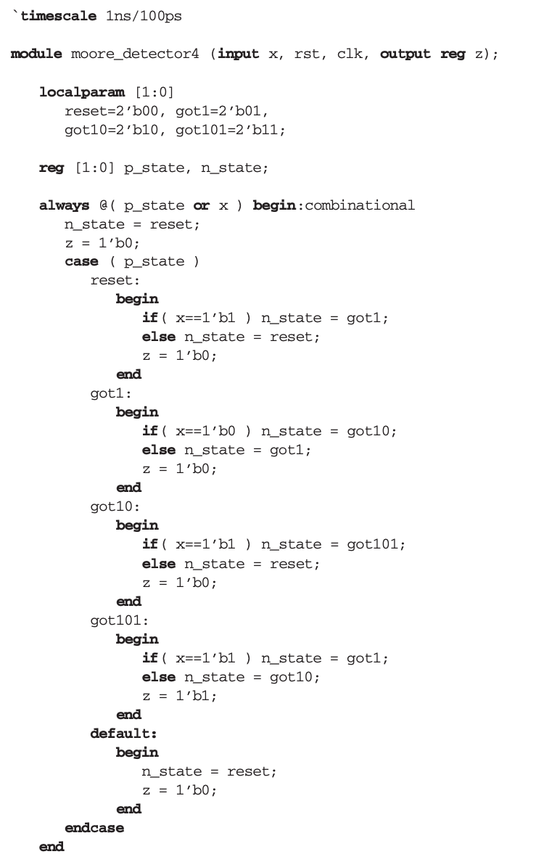
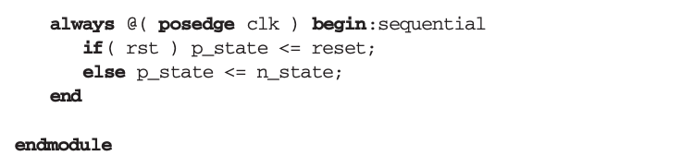

Slide 32
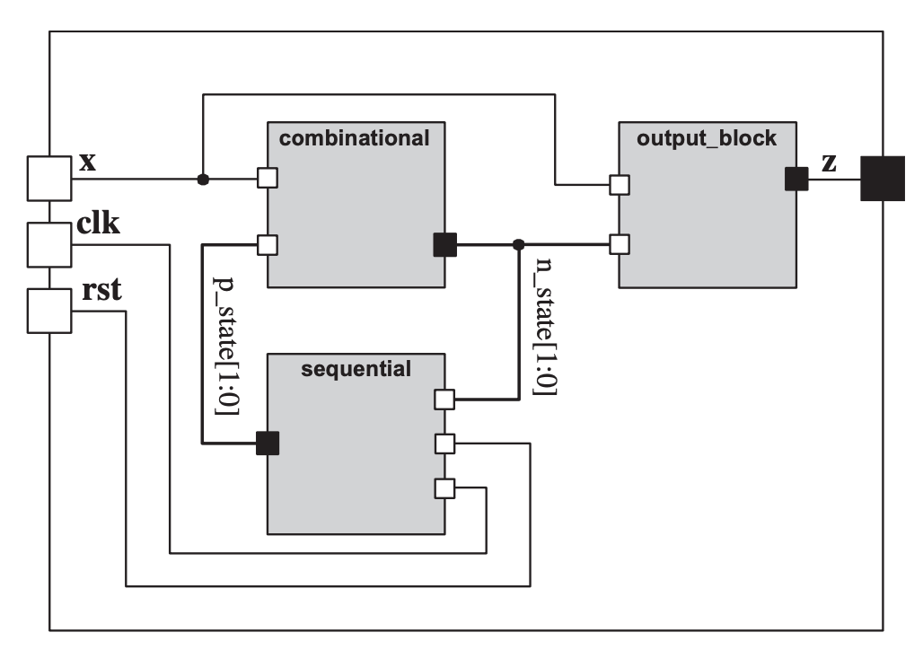
A More Modular Style
For a design with more input and output lines and more complex output logic, the combinational block may further be partitioned into a block for handling transitions and another for assigning values to the outputs of the circuit.

Slide 33
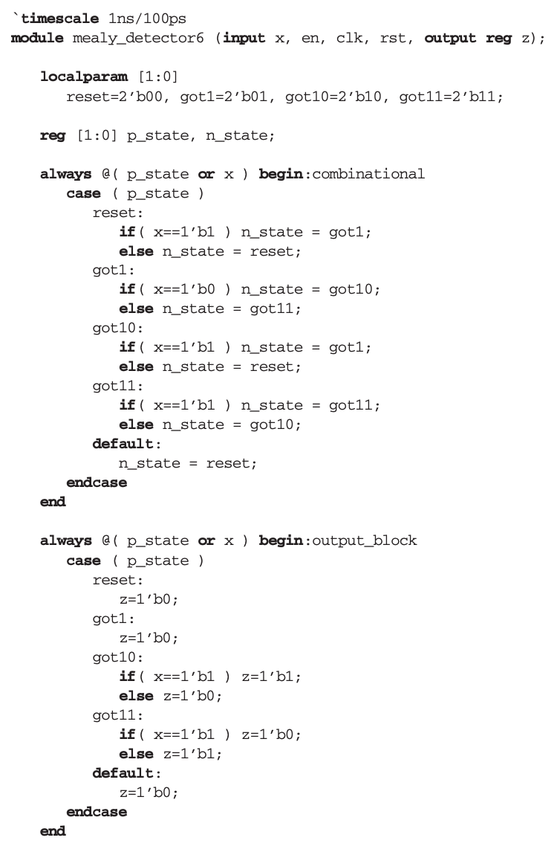
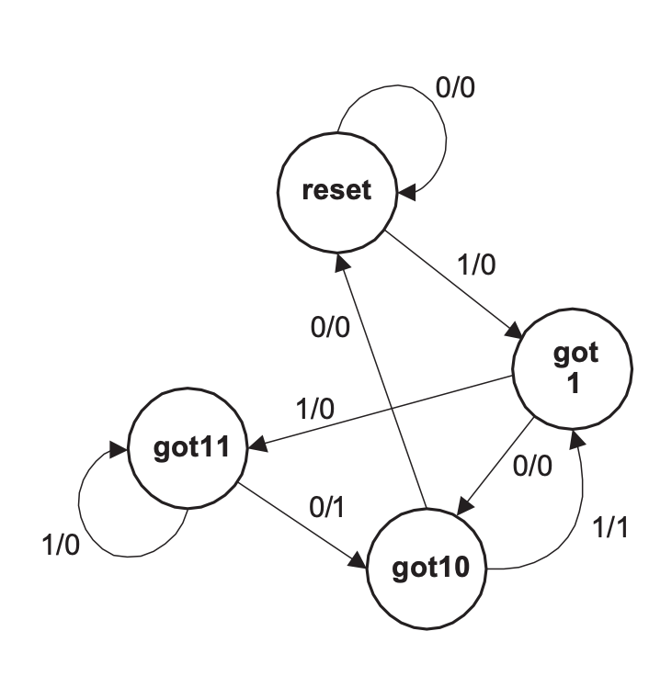
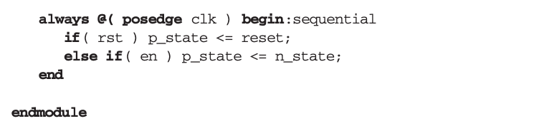
A Mealy Machine Using Three Procedural Blocks

Slide 34
A ROM based controller
Instead of coding state transitions and output values using case and/or if-else statements, a single memory lookup can be used for representing the combinational part of a state machine.
The memory lookup uses the present state of the machine and its inputs for address, and reads the next state and the controller outputs as data from the memory.

Slide 35
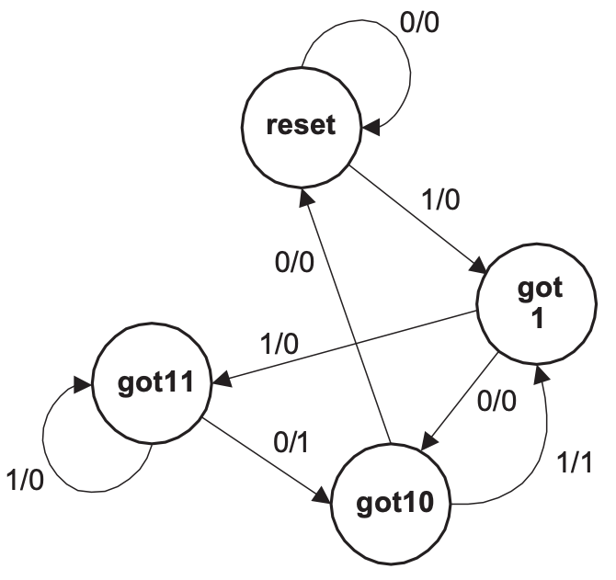
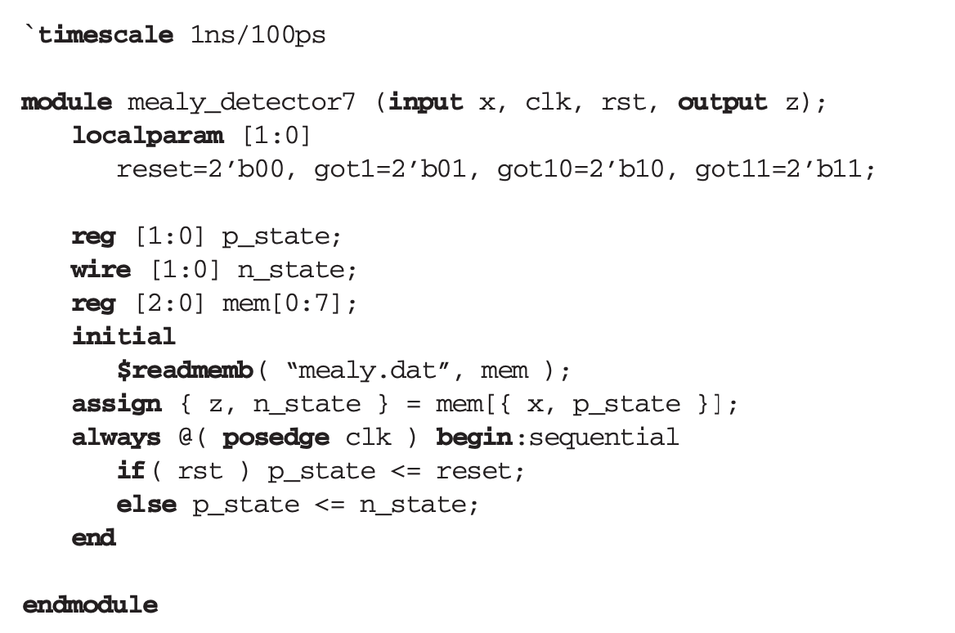

ROM Based Controller: An Example
mealy.dat Memory File

